Slide 1
Banking Management Application
Name-Pramodini Bhujabal
Batch-6973

Slide 2
Objective
The main objective of the Banking Management Application is to manage the details of accounts,transaction,balance,Statement.
The system provides the access to the customer to create an accounts,deposit,withdraw the cash from his accounts,also to view reports of all accounts present.
It manages all the information about accounts,customer,statement.
we will learn how to create a mini-application for a banking system in Java. In this program, we will add some basic functionalities of a bank account like a deposit of amount, withdrawal of amount, etc.
the program accepts the number of customers we need to add and adds the customer and account details accordingly. Further, it displays the series of menus to operate over the accounts.
The series of menus displayed are as follows:
1.Display all account details
2.Search by account number
3.Deposit the amount
4.Withdraw the amount
5.Exit

Slide 3
Advantages
It manages all the transaction like new account entry,deposit,as well as withdraw entry,transaction entry,transaction of money for various process.
Reduction in cost operation.
Secure transaction.
Support multiple accounts.
Simplicity of use.
24/7 availability.

Slide 4
Software Specification
Eclipse
Eclipse is an ide(interactive development environment)written to develop and debug(primarily) java code.it contains a base workspace and an extensible plug-in system for customizing the environment.
Os:windows Xp
Compiler:JDK(java)

Slide 5
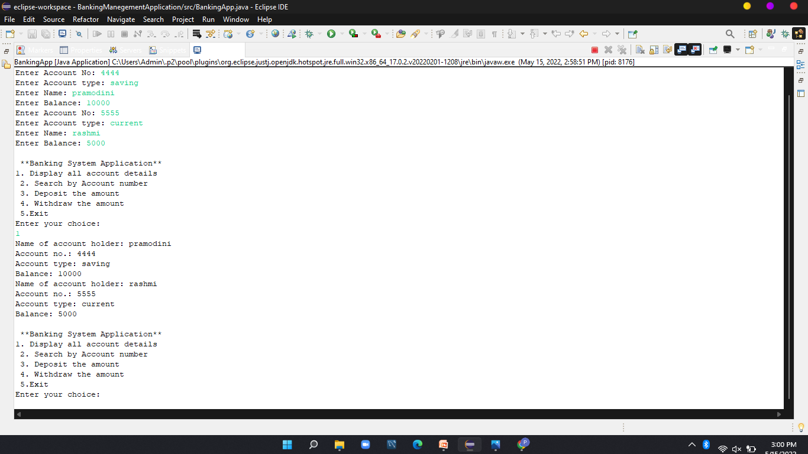
Display all account details

Slide 6
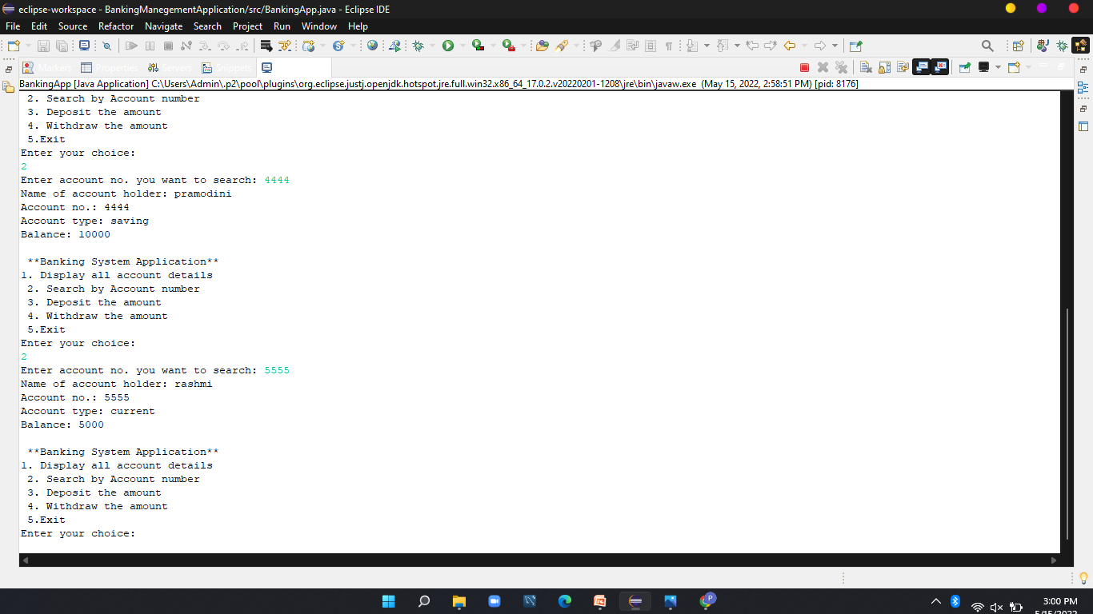
Search by account number

Slide 7
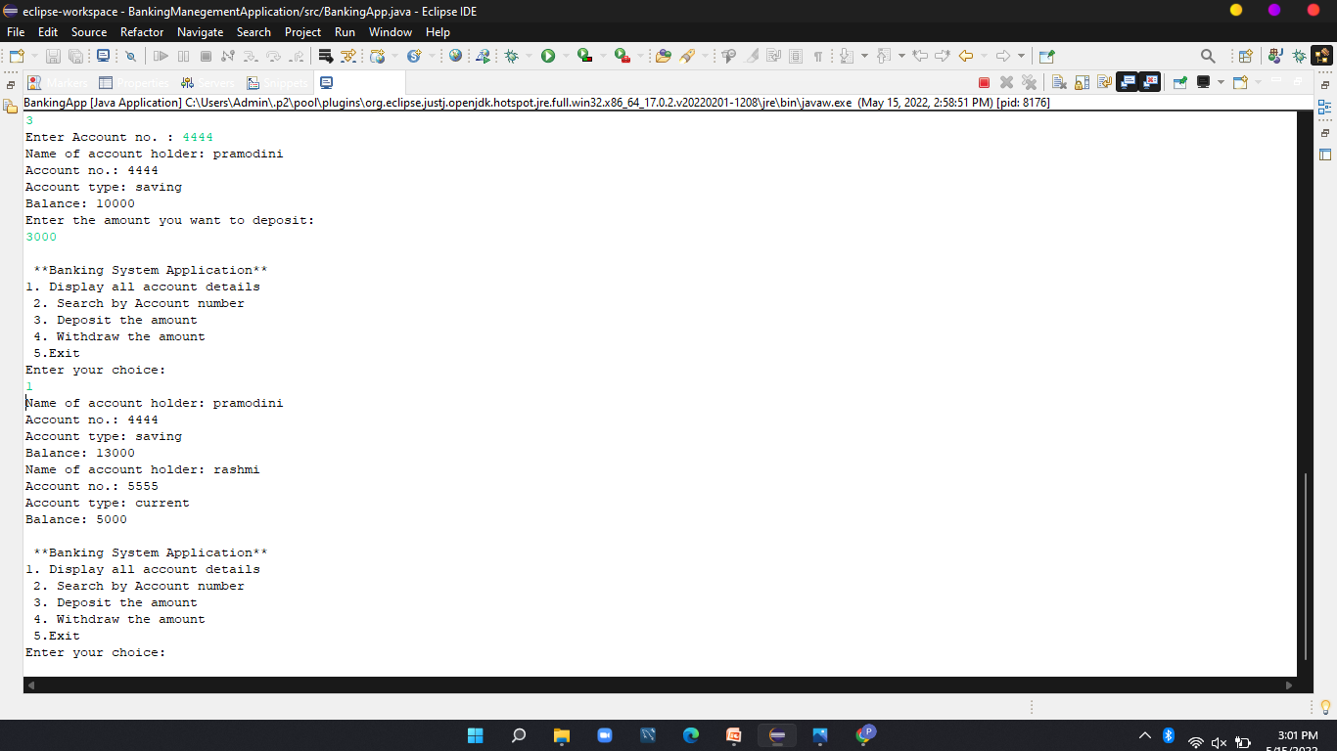
Deposit amount in account

Slide 8

Withdraw the amount

Slide 9
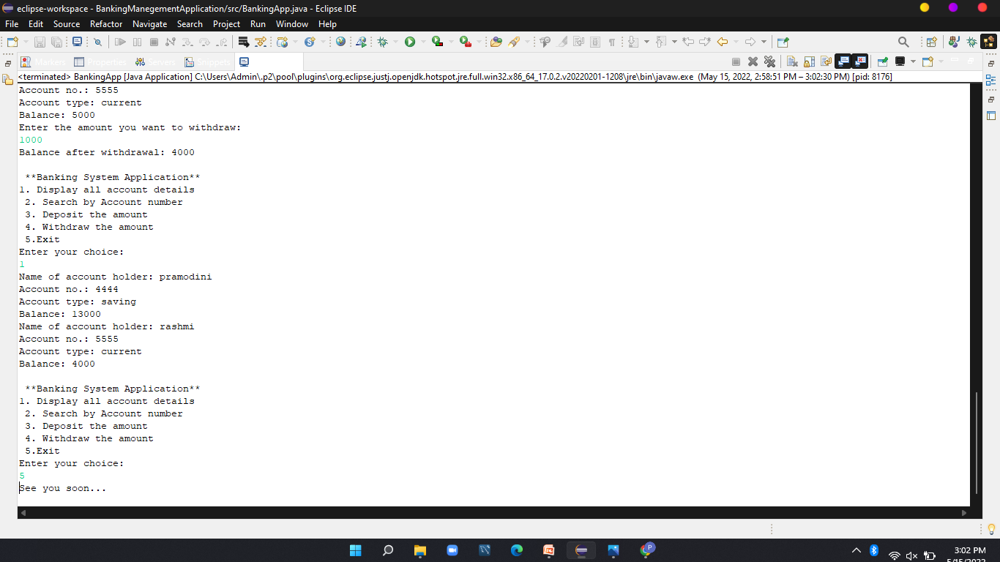
exit

Slide 10
Conclusion
From all the information we can create a bank management application. The whole process of banking is showed in the code like finding account details,deposit,withdraw,display all deatails about account.Hence we can conclude that project accomplished sucessfully.

Slide 11
THANK YOU

